Slide 1
Queue ADT and Application
CPSC 131- Data Structures
Shrinivas Patil

Slide 2

Queue ADT
Queue: data structure that organizes elements into FIFO
FIFO: First In, First Out
FIFO principle
A Queue is like a line waiting to purchase tickets,
The first person in line is the first person serve
the first entry that will be removed from the queue
Front (head) - The element is removed
Rear (tail)- The element is inserted

Slide 3
Types of Queue
Simple Queue
A regular queue based on FIFO principle
Priority Queue
Used to assign priority to element
Elements with higher priority will be deleted first
Two types - min priority and max priority queue
Used to implement sorting and scheduling algorithms
Circular Queue
Front and end of the queue are connected
Used in O.S. to manage memory
Dequeue
Elements can be added or deleted from both the ends

Slide 4
Queue Operations
Enqueue(x): add element x to the last position
Front(): return the element at the first position
Queue must not be empty
Dequeue(): remove the element at the first position
Queue must not be empty

Slide 5
Sketching a Queue
Row of boxes
Each element in a box
Front element is to the left (implicit)
Back element is to the right (implicit)
Queue containing 6 (first), 5, 7 (last)
6
5
7

Slide 6
Example Queue Operations
Create empty

Slide 7
Example Queue Operations
Create empty
Enqueue(“Alice”)

Slide 8
Example Queue Operations
Create empty
Enqueue(“Alice”)
Alice

Slide 9
Example Queue Operations
Create empty
Enqueue(“Alice”)
Enqueue(“Bob”)
Alice

Slide 10
Example Queue Operations
Create empty
Enqueue(“Alice”)
Enqueue(“Bob”)
Alice
Bob

Slide 11
Example Queue Operations
Create empty
Enqueue(“Alice”)
Enqueue(“Bob”)
Enqueue(“Carol”)
Alice
Bob

Slide 12
Example Queue Operations
Create empty
Enqueue(“Alice”)
Enqueue(“Bob”)
Enqueue(“Carol”)
Alice
Bob
Carol

Slide 13
Example Queue Operations
Create empty
Enqueue(“Alice”)
Enqueue(“Bob”)
Enqueue(“Carol”)
Dequeue()
Alice
Bob
Carol

Slide 14
Example Queue Operations
Create empty
Enqueue(“Alice”)
Enqueue(“Bob”)
Enqueue(“Carol”)
Dequeue()
Bob
Carol

Slide 15
Example Queue Operations
Create empty
Enqueue(“Alice”)
Enqueue(“Bob”)
Enqueue(“Carol”)
Dequeue()
Enqueue(“Diego”)
Bob
Carol

Slide 16
Example Queue Operations
Create empty
Enqueue(“Alice”)
Enqueue(“Bob”)
Enqueue(“Carol”)
Dequeue()
Enqueue(“Diego”)
Bob
Carol
Diego

Slide 17
Example Queue Operations
Create empty
Enqueue(“Alice”)
Enqueue(“Bob”)
Enqueue(“Carol”)
Dequeue()
Enqueue(“Diego”)
Dequeue()
Bob
Carol
Diego

Slide 18
Example Queue Operations
Create empty
Enqueue(“Alice”)
Enqueue(“Bob”)
Enqueue(“Carol”)
Dequeue()
Enqueue(“Diego”)
Dequeue()
Carol
Diego

Slide 19
Example Queue Operations
Create empty
Enqueue(“Alice”)
Enqueue(“Bob”)
Enqueue(“Carol”)
Dequeue()
Enqueue(“Diego”)
Dequeue()
Dequeue()
Carol
Diego

Slide 20
Example Queue Operations
Create empty
Enqueue(“Alice”)
Enqueue(“Bob”)
Enqueue(“Carol”)
Dequeue()
Enqueue(“Diego”)
Dequeue()
Dequeue()
Diego

Slide 21
Queue Applications
CPSC 131 - Data Structures
Shrinivas Patil

Slide 22
Queue Application
BFS traversal
Task Scheduling
Batch processing
Message Buffering
Traffic management
Spotify Play Queue
YouTube play Queue

Slide 23
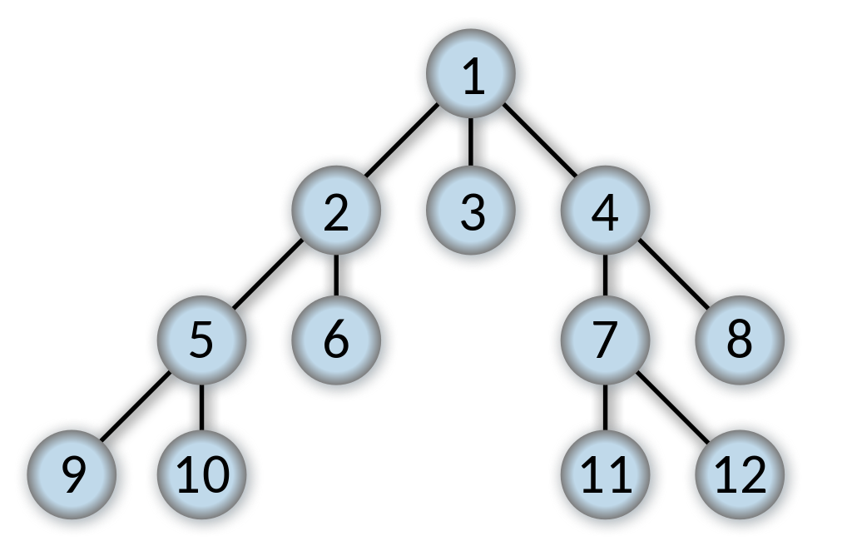
Computing Application: Breadth-First Search (BFS)
Another algorithm for traversing a graph
Advanced data structures, or algorithms, topic
Alternative to depth-first search (DFS) mentioned in Stack Applications
Uses queue as TODO list of unexplored vertices
Image credit: https://commons.wikimedia.org/wiki/File:Breadth-first-tree.svg , CC-BY

Slide 24
Queue Implementation using Linked List
CPSC 131 - Data Structures
Shrinivas Patil

Slide 25
Queue to List Correspondence
7
1
4
Queue manipulates two ends
Enqueue: last position
Front, Dequeue: first position
List has two ends: front, back
Q: how do they correspond?
queue front = list front?, or
queue front = list back?
Again, analyze based on asymptotic analysis (big-O)
dum
7
1
4
dum
4
1
7

Slide 26
Queue to List Correspondence
Queue front = list front
List
size=3 tail
7
1
4
dum
7
1
4

Slide 27
Queue to List Correspondence
Operation | SLL | DLL
Front, PushFront, PopFront | O(1) | O(1)
Back, PushBack | O(1) | O(1)
PopBack | O(n) | O(1)
If queue front = list front: Enqueue, Front, Dequeue are O(1)
If queue front = list back: Dequeue slows down to O(n) w/ SLL
Decision: queue front = list front
No advantage to DLL, so choose SLL

Slide 28
Data Members, Constructor, Size
template <typename T> class LinkedQueue { public: LinkedQueue() { } size_t Size() { return list_.Size(); } … private: SLList<T> list_; };
Just a singly-linked list
Reuse SLL operations
Both are O(1) time

Slide 29
Enqueue(x)
void Enqueue(T x) { list_.PushBack(x); }
Just add a back element
(Stack added front)
No error check needed
O(1) time

Slide 30
Front
T Front() { if (Size() == 0) { throw std::out_of_range(“empty queue”); } return list_.Front(); }
Check for empty queue
Just return the list’s front element
O(1) time

Slide 31
Dequeue
void Dequeue() { if (Size() == 0) { throw std::out_of_range(“empty queue”); } list_.PopFront(); }
Check for empty queue
Just remove the list’s front element
O(1) time

Slide 32
Linked List-Based Queue Analysis Summary
Operation | Time Efficiency
Default constructor (create empty) | O(1)
Size | O(1)
Enqueue(x) | O(1)
Front() | O(1)
Dequeue() | O(1)

